Slide 1
Digital Prescription Record Analysis
Presented By
B.Bhavya

Slide 2
Problem Statement
Healthcare organizations generate a large number of prescription records daily. Managing these records manually can lead to errors, inefficiencies, and difficulties in tracking medicine usage and patient treatment patterns.

Slide 3
Scope
The project focuses on managing and analyzing prescription-related healthcare data.
Features Covered
Prescription record analysis.
Disease trend monitoring.
Medicine utilization tracking.
Inventory monitoring.
Visual analytics using charts.

Slide 4
Architecture
CSV Healthcare Data
↓
Data Cleaning (Pandas)
↓
MySQL Database
↓
SQL Queries
↓
Data Visualization
↓
CLI Analytics Tool

Slide 5
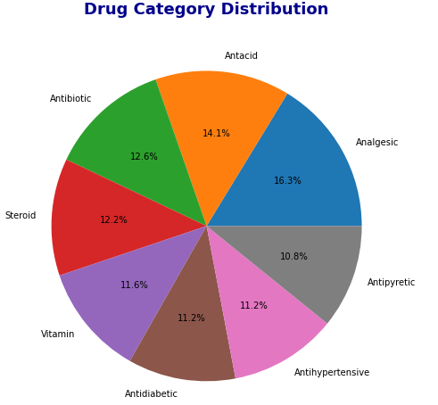
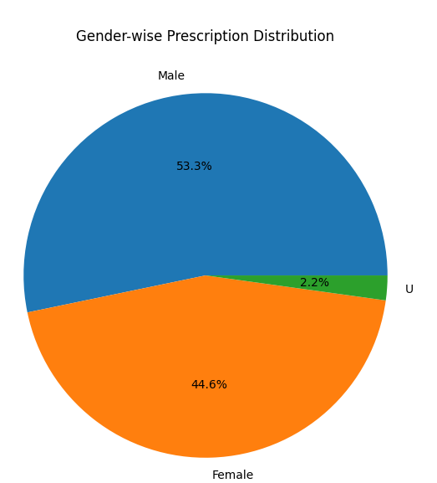
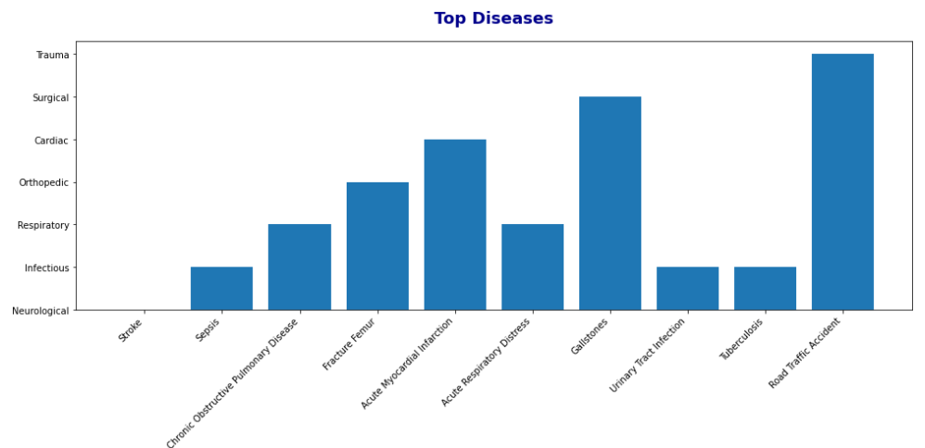
Charts

Slide 6
Conclusion
The project successfully demonstrates how healthcare data can be digitized, analyzed, and visualized to support better decision-making and improve operational efficiency.

Slide 7
THANK YOU

